Slide 1


Cairo University · Faculty of Computers and AI
Introduction to Software Engineering – CS251
Assignment 2
Smart Wallet — SDS
Name
ID
E-mail
Sec.
Team Leader
Yassen Mohamed Abdelaziz ★
20240663
20240663@stud.fci-cu.edu.eg
S26
Yassen Mohamed
Ali Ahmed Mahmoud
20240331
20240331@stud.fci-cu.edu.eg
S3
Abdelaziz
Abdullah Yousef Abdullah
20240337
20240337@stud.fci-cu.edu.eg
S25
ID: 20240663
Sayed Mamdouh
20240256
20240256@stud.fci-cu.edu.eg
S26
📞 01064681901
S26
Smart Wallet · Software Design Specification · Cairo University 2024

Slide 2

💰 Smart Wallet
Personal Finance Management System
A full-stack Django web application for budgeting, saving goals,
transaction tracking, and AI-powered financial advice.
6
5
5/5
10+
Models
Apps
SOLID
Features
Built with Django · Python · AI Integration

Slide 3
PROJECT OVERVIEW
Wallet Management
Transactions
Budget Control
Track balance, income, and expenses in real-time with a personalized wallet per user.
Full CRUD for income, expenses, savings, and money transfers with category tagging.
Set category budgets with start/end dates, track spending, and get auto-alerts.
Saving Goals
Notifications
AI Advisor
Create financial goals with deadlines, monitor progress, and auto-update status.
Real-time alerts for deposits, sends, budget exceeded, and goal completion.
LLM-powered financial advisor that reads live wallet data to give personalized tips.

Slide 4
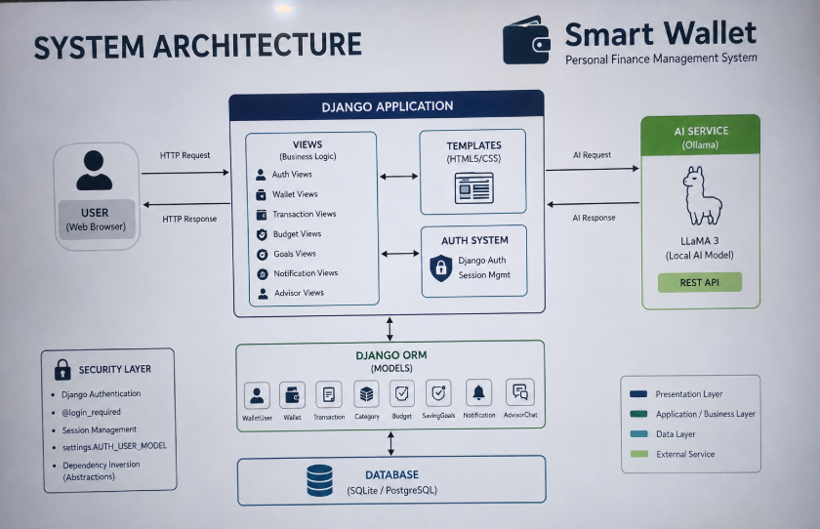
System Archetecture

Slide 5
SYSTEM ARCHITECTURE
user
transactions
notifications
advisor
core/views
WalletUser
Wallet
Transaction
Category
Budget
SavingGoals
Notification
AdvisorChat
Auth, Home
Deposit, Report
Django ORM → SQLite / PostgreSQL → Models → Views → Templates (HTML5)
🔐 Django Auth · Session · @login_required
🤖 Ollama (LLaMA 3) · Local AI · REST API

Slide 6
SOLID
DESIGN PRINCIPLES
How Smart Wallet applies every SOLID principle
S
O
L
I
D
Single Responsibility
Open/Closed
Liskov Substitution
Interface Segregation
Dependency Inversion

Slide 7
S
Single Responsibility Principle
"Every class, model, and view in Smart Wallet has one — and only one — reason to change."
WalletUser (models.py)
Wallet (models.py)
Handles user identity only.
No financial logic inside the user model.
Stores balance, income, expense totals.
No auth, no business logic beyond fields.
view_deposit() (views.py)
Notification (models.py)
One job: process a deposit POST.
Separate views for login, register, home, report.
Only stores & retrieves notifications.
Creation logic is in create_notification() helper.
AdvisorChat (models.py)
call_ai() vs view_advisor()
Stores conversation history only.
AI call logic lives in call_ai() separately.
AI HTTP call is isolated in call_ai().
View only orchestrates — single responsibility.

Slide 8
O
Open/Closed Principle
"Open for extension, closed for modification — new features added without touching existing code."
✅ Transaction.TYPE_CHOICES
Extension Pattern
New transaction types (e.g. 'loan') can be added to TYPE_CHOICES without modifying existing view logic or model methods.
TYPE_CHOICES = [
('income', 'Income'),
✅ Notification.TYPE_CHOICES
('expense', 'Expense'),
New notification types (GOAL_PROGRESS, SEND_MONEY) were added without changing mark_read() or delete_notification() views.
('saving', 'Saving'),
('send', 'Sending'),
# ✅ Add here freely:
✅ Budget.status_choices
('loan', 'Loan'),
Budget statuses (active, expired, completed) extend via new choices; existing save/update logic is untouched.
]

Slide 9
L
Liskov Substitution Principle
"Subtypes are fully substitutable for their base — WalletUser can replace AbstractUser anywhere."
AbstractUser (Django)
▼ extends
WalletUser (custom)
✅ All AbstractUser methods work unchanged
✅ authenticate(), login(), logout() — no changes needed
✅ @login_required works with WalletUser transparently
✅ get_user_model() returns WalletUser everywhere
✅ Admin panel, permissions, groups — all intact

Slide 10
I
Interface Segregation Principle
"No view is forced to handle logic it does not need — each view does exactly what its URL demands."
URL Route
View Function
Responsibility
/
view_intro()
Landing page only
/home/
view_home()
Dashboard + transactions
/deposit/
view_deposit()
Deposit logic only
/notifications/
view_notifications()
Notification list only
/advisor/
view_advisor()
AI chat only
/logout/
view_logout()
Session clear only

Slide 11
D
Dependency Inversion Principle
"High-level views depend on abstractions (get_user_model, settings.AUTH_USER_MODEL), not concrete classes."
Direct Coupling
Dependency Inversion
# ❌ Direct coupling (WRONG)
# ✅ Inversion via settings (CORRECT)
from user.models import WalletUser
from django.conf import settings
class Notification(models.Model):
class Notification(models.Model):
user = models.ForeignKey(
user = models.ForeignKey(
WalletUser, # concrete!
settings.AUTH_USER_MODEL,
on_delete=models.CASCADE
on_delete=models.CASCADE
)
)
get_user_model()
settings.AUTH_USER_MODEL
call_ai() abstraction
views.py uses get_user_model() instead of importing WalletUser directly — swap auth model freely.
All ForeignKey/OneToOne relations use AUTH_USER_MODEL — the concrete model is injected via config.
view_advisor() calls call_ai() function — switch from Ollama to OpenAI by changing only call_ai().

Slide 12
SOLID AT A GLANCE
S
Single Responsibility
view_deposit(), view_login() — separate functions
Each view/model has one job
O
Open / Closed
TYPE_CHOICES, status_choices extensible
Add types without modifying existing code
L
Liskov Substitution
get_user_model(), AbstractUser extended cleanly
WalletUser substitutes AbstractUser
I
Interface Segregation
view_notifications() ≠ view_advisor() ≠ view_home()
Views expose only what their URL needs
D
Dependency Inversion
settings.AUTH_USER_MODEL, call_ai() abstraction
High-level code uses abstractions

Slide 13
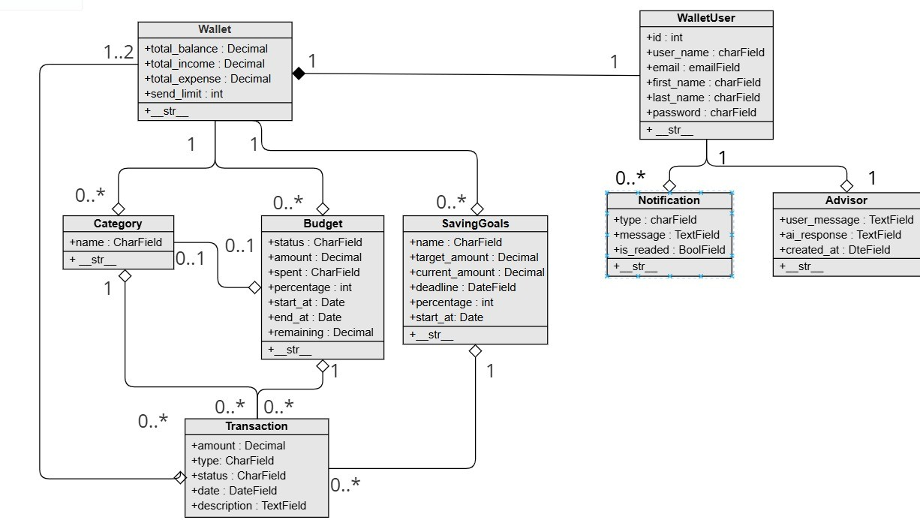
DATA MODELS & RELATIONSHIPS

Slide 14
💰
Smart Wallet
Built on SOLID principles — Designed to scale.
Django
Python
SQLite
Ollama / LLaMA 3
HTML5 / CSS3
SOLID Architecture
Thank you!

